Slide 1
Cape Coral Hospital
Welcome The Joint Commission
Levels of Maternity Care

Slide 2




Slide 3

CAPE CORAL HOSPITAL OVERVIEW- FY 2023
Total Adult Admissions – FY 2022- 14,687
Total ED Visits – 69, 366
Total Surgery Volume – 7,906
Total Births – 1,480
Imaging Tests/Procedures – FY22– 61,045
Full - Service ICU
6 PCU Units in the Hospital

Slide 4





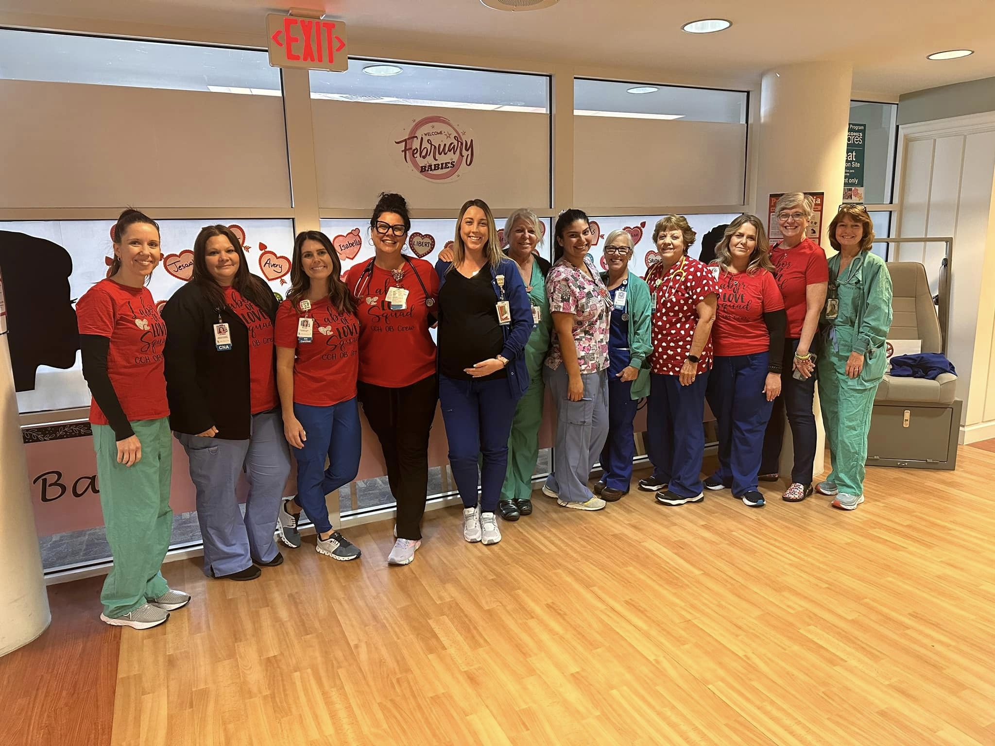
Welcome to the Family Birth Suites
https://vimeo.com/497982488

Slide 5
Welcome to the Family Birth Suites
LDPR Model of Care
23 Bed Single Room Maternity Care Unit
5 Bed OB Triage
2 Obstetrical Operating Rooms
2 Obstetrical PACU Bays
6 Bed Special Care Nursery

Slide 6


AWARDS and NATIONAL RECOGNITION
Lee Health High Reliability Award, November 2022
Baby Friendly Designated Hospital since 2018
Florida Quest for Quality Maternity Care Award
National Certified Gold Safe Sleep Champion
Hepatitis B Birth Dose Honor Roll since 2020
Breastfeeding Friendly Employer Award since 2012

Slide 7

We’re excited to share that U.S. News and World Report has designated Cape Coral Hospital as a High Performing hospital for Maternity Care
U.S. News & World Report has released its first-ever research paper on the best hospitals for maternity care. To come up with this list the organization analyzed how well hospitals perform in childbirth using C-section rates, newborn complication rates, breast milk feeding rates, early elective delivery rates, routine vaginal birth after cesarean delivery rates, and episiotomy rates. U.S. News also examined if a hospital meets the federal criteria for "birthing-friendly" practices.
"All families deserve to be informed on how hospitals perform," Ben Harder, managing editor and chief of health analysis at U.S. News & World Report, told USA Today. "Our hope is that this initiative will push hospitals in general—and especially underperforming hospitals—to redouble their efforts to provide the same high-quality care."

Slide 8

Best Hospitals for Maternity Care
“You and your newborn(s) want the best care a hospital can offer a new life. Money and The Leapfrog Group’s Best Maternity Care Hospitals highlights the institutions that deliver just that.”
Cape Coral Hospital was named to this list in 2022.

Slide 9

Florida Perinatal Quality Collaborative
Early Elective Delivery
Obstetric Hemorrhage
Hypertension in Pregnancy
Perinatal Indicators
Maternal Opioid Recovery Effort
Mother’s Own Milk
Promoting Primary Vaginal Deliveries
Birth Certificate Improvement
Postpartum Access & Continuity of Care
Maternity Levels of Care
Social Determinants of Health

Slide 10
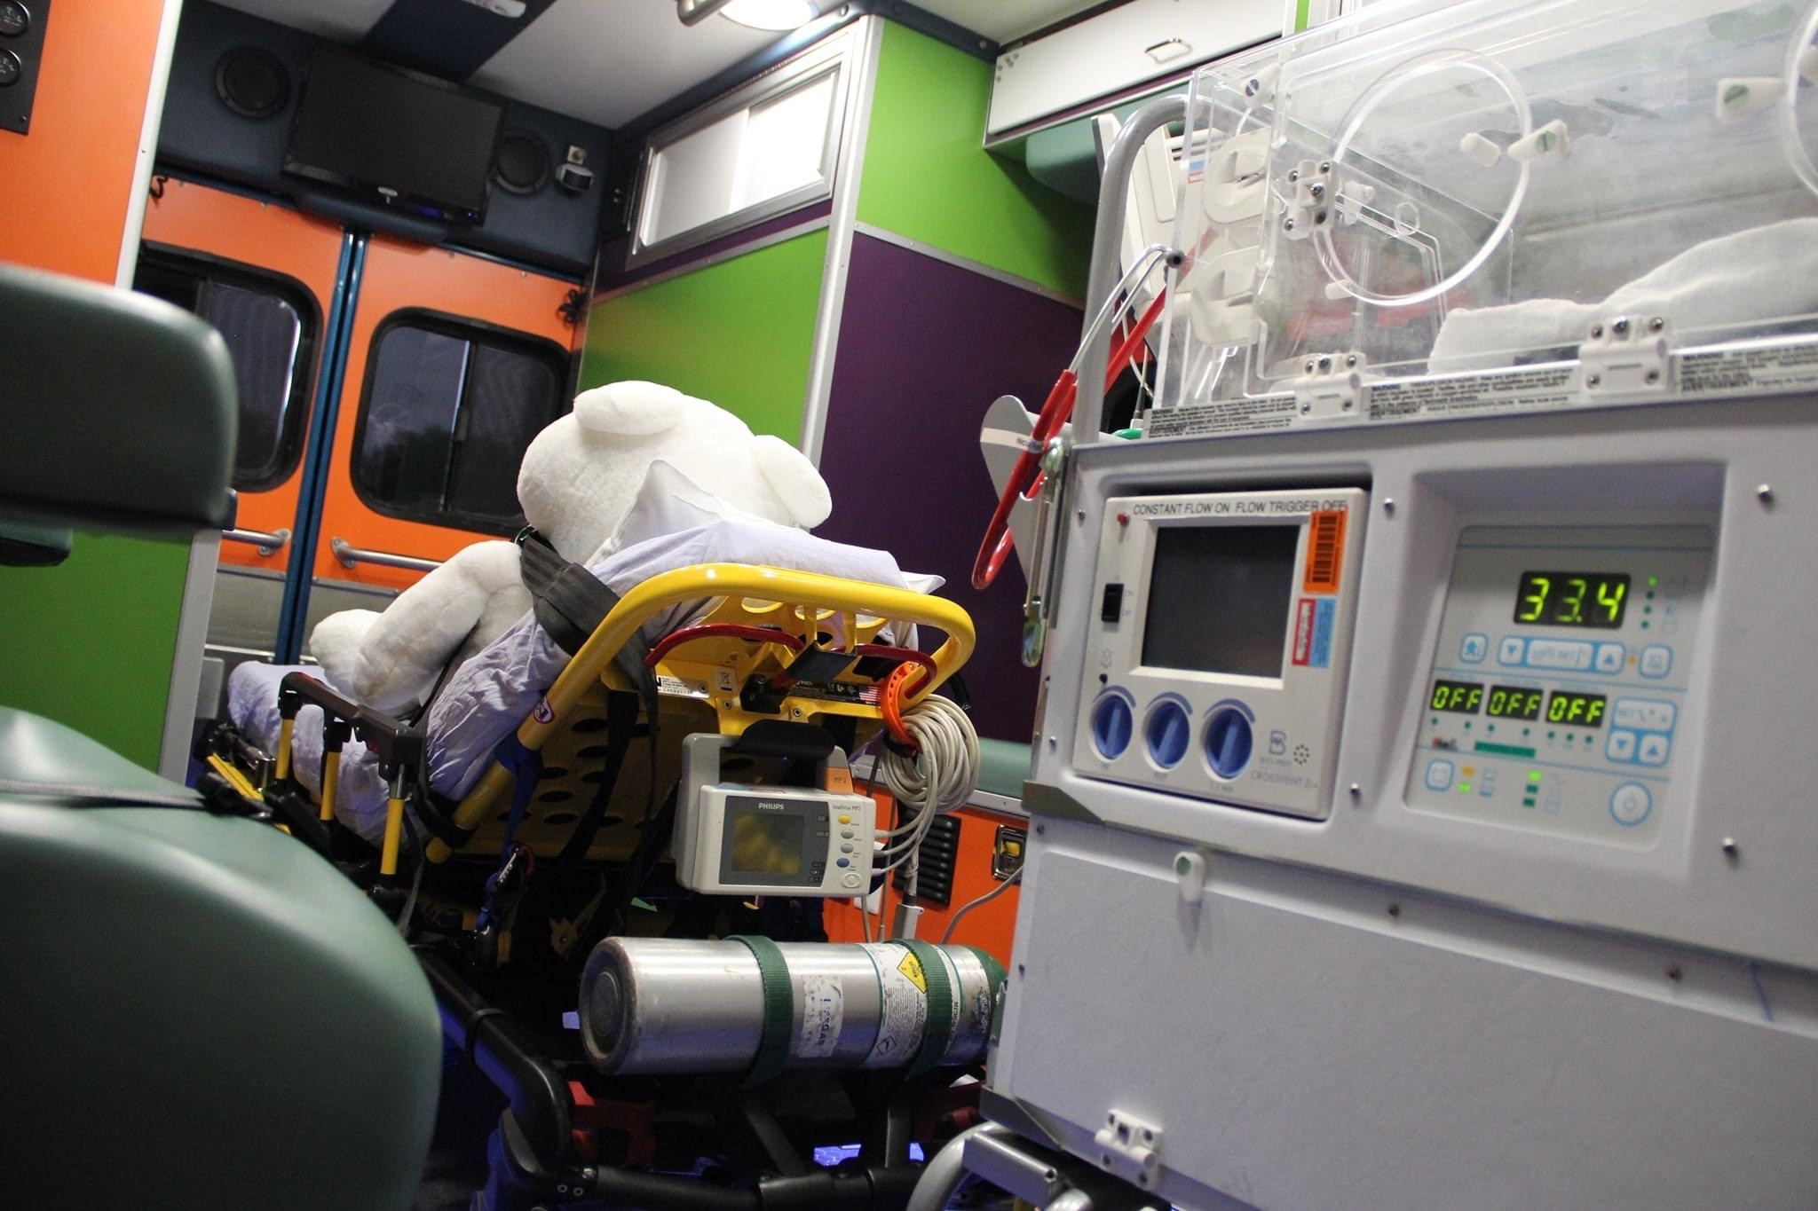

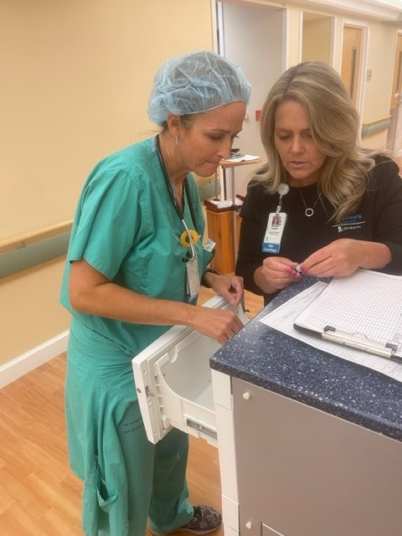
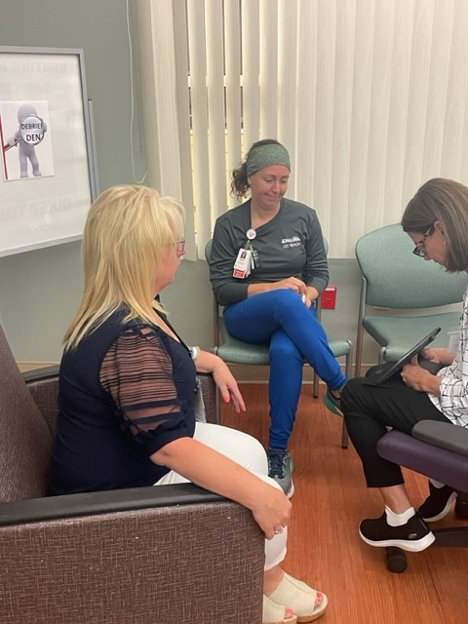
More About Us
Maternal Neonatal Transport Team Availability
PeriGen for Centralized Fetal Monitoring
Remote Fetal Monitor Cart
Fetal Monitoring Telemetry System
Cardiac Telemetry Monitoring
Updated OB Hemorrhage Carts
Debriefing Room

Slide 11
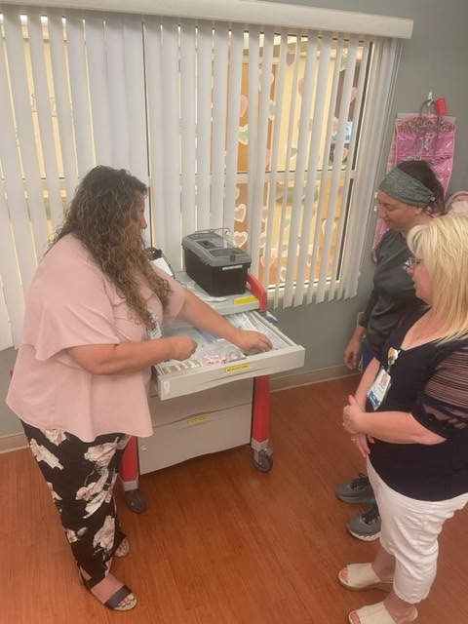
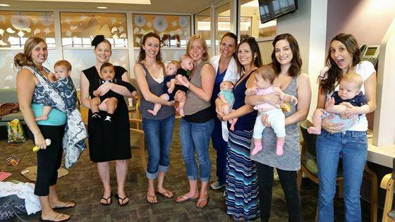
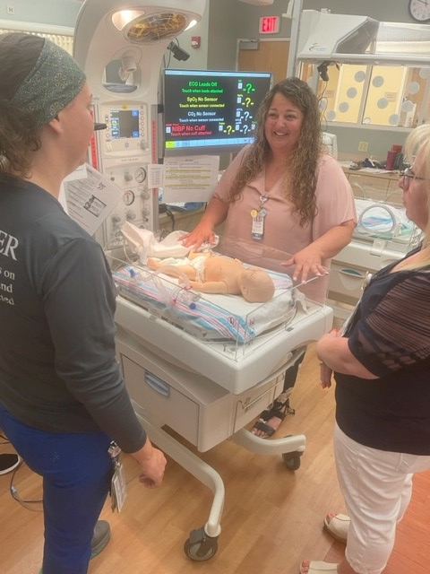
More About Us
NICLet Care Model
Caregility to contact Neonatologists
Breastfeeding Support Group Weekly
Baby Weight Station
Neonatal Simulation Lab On Site
Nursing Staff Certified as Breastfeeding Counselors

Slide 12

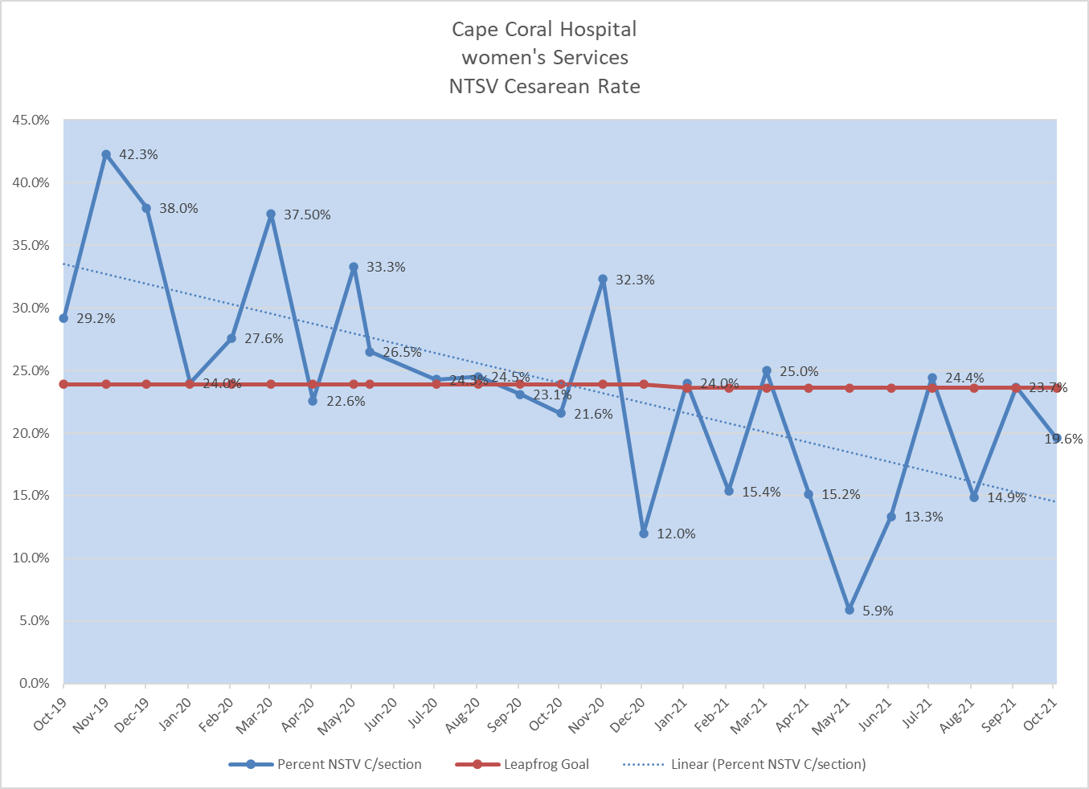


Benefits of Delaying Hospital Admission in Early Labor
Amy Brown, MSN, APRN, FNP-BC; Darlene B. Comer MSN, RNC-OB, CBC; Sabrina Perez RNC, CBC; Sara Stevens RNC, CBC
QUALITY IMPROVEMENT IN PATIENT OUTCOMES AND NORMAL TERM SINGLTON VERTEX (NTSV) RATES
Background
Early labor (latent) is the first stage of labor where contractions occur irregularly causing initial cervical dilatation or change.
Contractions may painful and irregular
There is no specific time range for latent labor, may last between 6- 36 hours.
Women who are admitted to the hospital during this stage are potentially exposed to unnecessary medical interventions.
In order to improve outcomes women are encouraged to stay home until active labor.
Early medical intervention leads to increased risk of limited mobility and prolonged labor.
Research/ Methods
Research shows the relationship between labor support, early movement and delaying early admissions.
Quantitative data from deliveries was collected and analyzed as presented in the linear regression graph to the right.
The graph supports delaying admission to hospital until active labor reduces percentage for cesarean section.
Based on data collected women admitted to hospital in latent labor had a higher probability of early intrapartum intervention
Results / Outcomes
Conclusion
Delaying hospital admission until active phase of labor reduces risk for augmentation and cesarean section.
Encouraging movement promotes natural labor progression.
Prenatal education provides a solid knowledge-based understanding of normal labor, allowing for realistic expectations.
A unified team approach and effective communication among its members increases positive patient experience and desired outcomes.
Empowering woman to understand their body is perfectly designed for birth, can help ease fears associated with childbirth.
Research shows early education on pain management and coping mechanisms is highly beneficial to labor process.
The linear regression graph above exhibits the leapfrog national benchmark average as 23.6% for Nulliparous, Term, Singleton, Vertex cesarean section rates. Lee Health strives to remain below the benchmark average in reducing cesarean sections for first time mothers.
What did the nurses at Lee Health decide to do about it?
The Labor Walking Path
Established by labor nurses as an educational and physical tool to promote ambulation in early phase of labor. QR codes along path provide educational and encouraging videos for the laboring woman and their support person. The labor walking path is located within the hospital and weather permitting outdoor area is available for use. Ambulation is a great way for laboring women transition from latent to active labor.
Tracking Primary Vaginal Deliveries
Barriers to Desired Outcomes
Medical/ maternal history of chronic conditions
Onset of acute conditions such as elevated BP
Nonreactive fetal tracing
Low tolerance to labor pain
Lack of maternal labor support
References
Chrastina, Jan. (2018). Meta- synthesis of Qualitative Studies: Background, Methodology and Applications. 10.32008/NORDSSCI2018/B1/V1/13.
Gaudernack, L. C., Michelsen, T. M., Egeland, T., Voldner, N., & Lukasse, M. (2020). Does prolonged labor affect the birth experience and subsequent wish for cesarean section among first-time mothers? A quantitative and qualitative analysis of a survey from Norway. BMC Pregnancy and Childbirth, 20(1). https://doi.org/10.1186/s12884-020-03196-0
Kauffman, E., Souter, V. L., Katon, J. G., & Sitcov, K. (2016). Cervical Dilation on Admission in Term Spontaneous Labor and Maternal and Newborn Outcomes. Obstetrics & Gynecology, 127(3), 481–488. https://doi.org/10.1097/aog.0000000000001294
Kissler, K., Jones, J., McFarland, A. K., & Luchsinger, J. (2019). A qualitative meta-synthesis of women’s experiences of labor dystocia. Women and Birth. https://doi.org/10.1016/j.wombi.2019.08.001
Rota, A., Antolini, L., Colciago, E., Nespoli, A., Borrelli, S. E., & Fumagalli, S. (2018). Timing of hospital admission in labour: latent versus active phase, mode of birth and intrapartum interventions. A correlational study. Women and Birth, 31(4), 313–318. https://doi.org/10.1016/j.wombi.2017.10.001

Slide 13
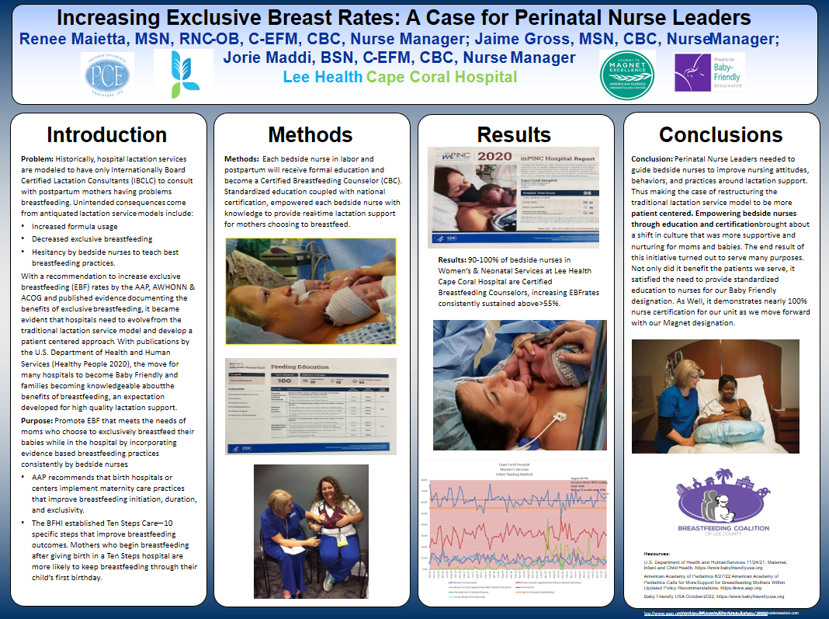

Slide 14
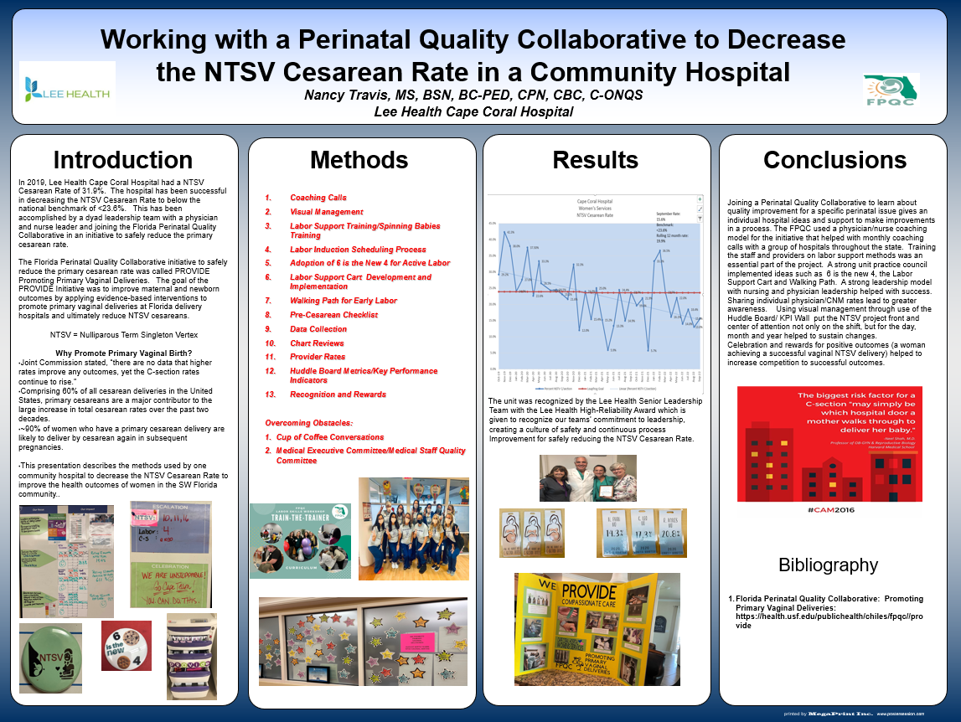

Slide 15
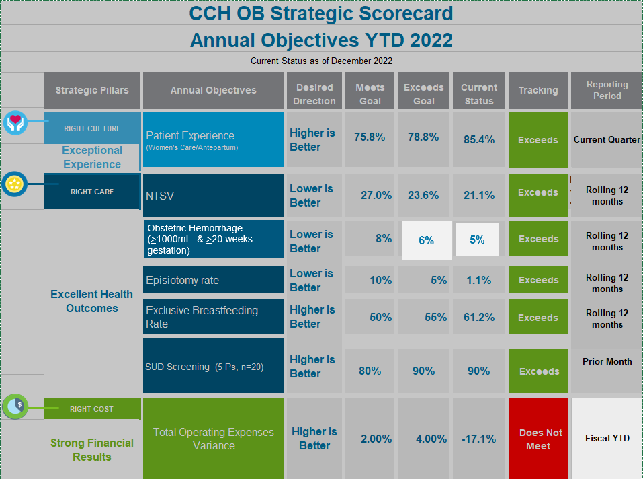


Slide 16
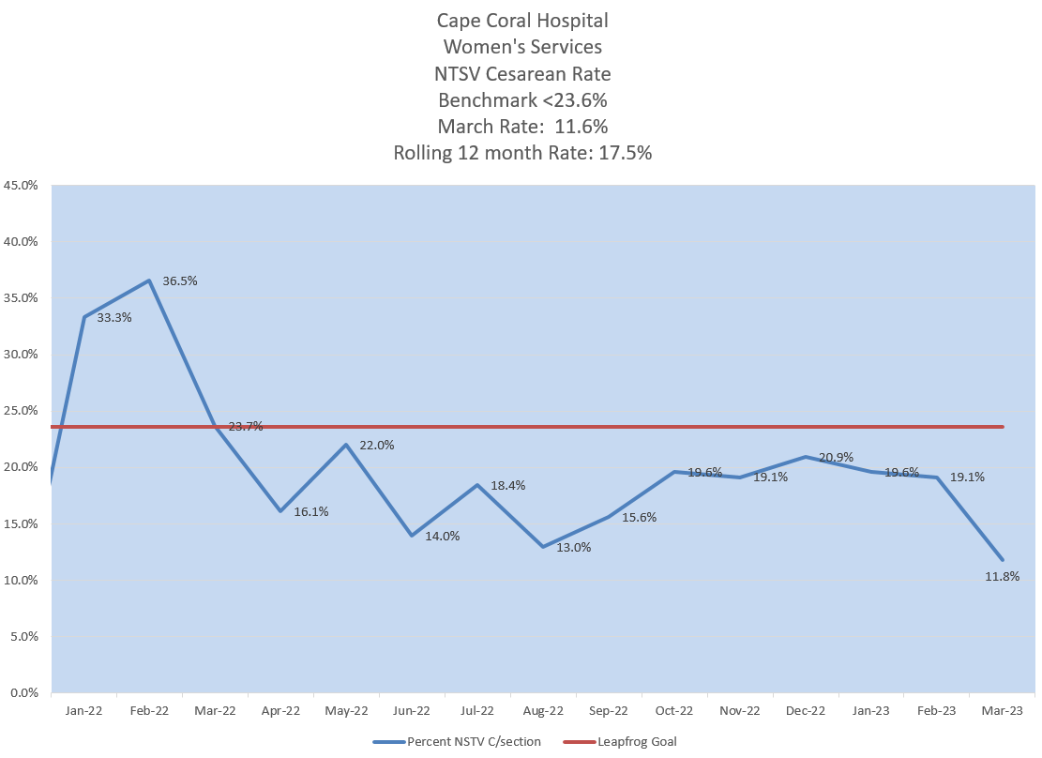

Slide 17
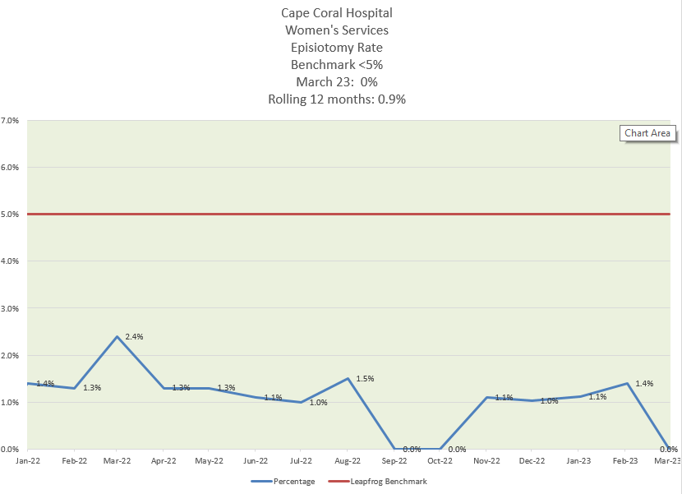

Slide 18
