Slide 1
Maternal Levels of Care Verification
Leadership Overview

Slide 2
Dates
Our readiness date is 4/3/23
Can change readiness date with 20 day notice
Avoid dates have been submitted
We will get a 30 day notice for initial survey
For re-verification surveys (in 3 years) we will get a 7 day notice
Three days prior to survey we need to upload specific documents to TJC sharepoint (more info on future slide)

Slide 3
Survey Overview
1 surveyor
Onsite for two days
Survey will occur every three years (separate from regular TJC survey)
Verification cycle begins the day after the last day of the survey
The surveyor will review:
5 current inpatients
Former patient (discharged) interview (1)
5 staff educational files (different disciplines) including perinatal program nursing director
5 physician files

Slide 4
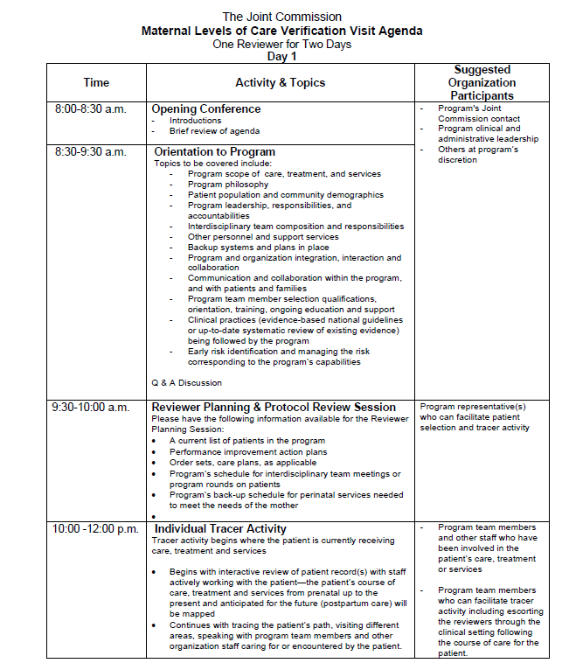
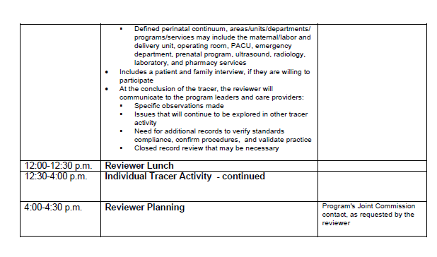
Day 1 Agenda

Slide 5
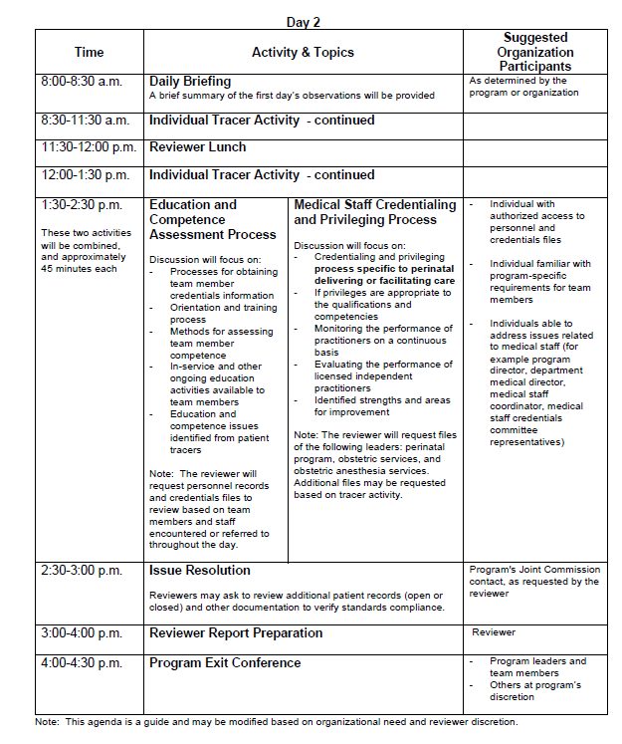
Day 2 Agenda

Slide 6
After Survey
Preliminary report will be posted to TJC website until midnight of the last day of our survey
Final report will be available within 10 business days
We will have 60 days to do our corrective action plan
We will receive an award letter and certificate 2 weeks after decision

Slide 7
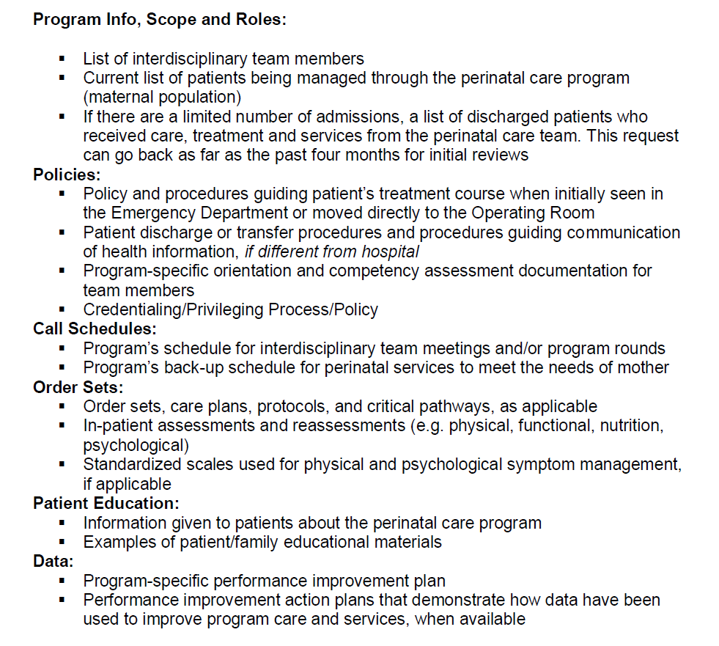
Documents to Upload to Sharepoint

Slide 8
Survey Preparedness
Prep agenda with participants: Lana
Upload TJC documents to sharepoint: Lana
Prepare documents for upload: Lana & Candy
PI Plan 2022/2023: Lana & Candy
Finalize policies and scope of practice: Lana & Candy
Opening presentation: Dr McLean
Staff educational files: Nursing Managers
Physician educational files
Prep staff for survey: Quality Reps
Identify and prep discharged patient for interview
Identify and prep inpatients for survey (during survey): Nursing Managers

