Slide 1


The Joint Commission
Maternal Levels of Care Verification
May 16 - 17, 2023

Slide 2



Who we are
UF Health Shands Hospital
Established in 1958
Main Campus: 3 Hospitals
  Shands Hospital: 683 beds
  Cancer Hospital: 192 beds
  Heart, Neuro and Vascular Hospital :216 beds

Slide 3

Mission, Vision and Values

Slide 4
Perinatal Program Philosophy
We believe that every pregnant or recently pregnant patient is entitled to receive the unique care that is tailored to her individual needs in order to promote the optimal outcome.
We believe this care should be standardized based on best available evidence, collaborative, patient centered and innovative when indicated.
To continuously improve and develop programs that will meet these goals.
To become the leader in regionalization of Perinatal care in Florida

Slide 5
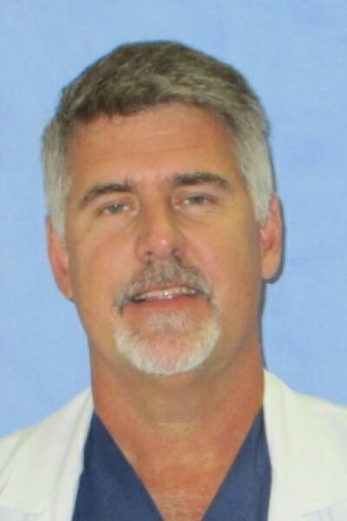


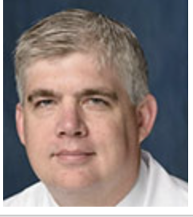
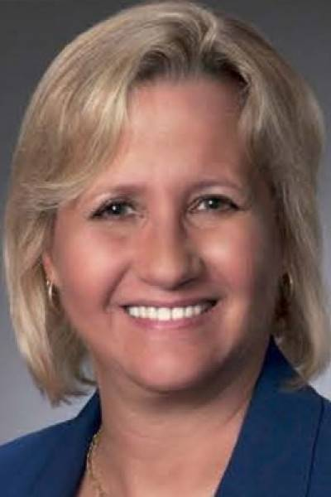






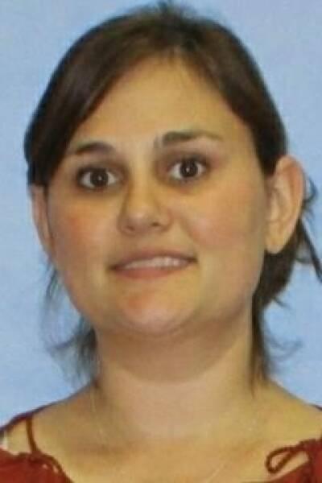
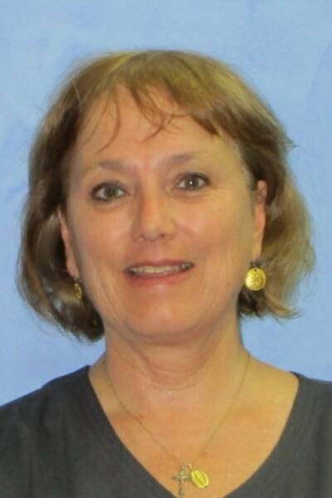

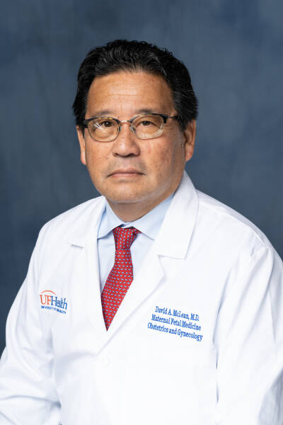
Meet the Team
AVP, Nursing: Dave Hudson, MSN, RN, NEA-BC
Interim CEO, Sr. VP, CFO: James J. Kelly, Jr.
COO, Traci D’Auguste, MBA,
CMO, Timothy E Morey, MD
CNO: Irene Alexaitis, DNP, RN,NEA-BC
CQO, Michele Lossius, MD
Department Chair of Obstetrics and Gynecology: Dr. John Smulian
Chief of Obstetrics and Gynecology: Dr. Tony Wen
Clinical Leader of Labor & Delivery: Joanne Tanner, MSN, RN, C-EFM
Clinical Leader of Mother/Baby: Emily Marchione, BSN, RN
Mgr, L&D: Jan Mackenzie, MSN, RNC-OB, C-EFM
Mgr., Mother/Baby: Dawn Viana, DNP, APRN, NNP-BC, RNC-NIC
CNS(Obstetrics): Candy Rouse, DNP, RN, C-EFM, CNS
Sr QI Specialist Lana Watson, MHS, OTR/L
Physician Director of Quality (Obstetrics and Gynecology): Dr. David McLean

Slide 6
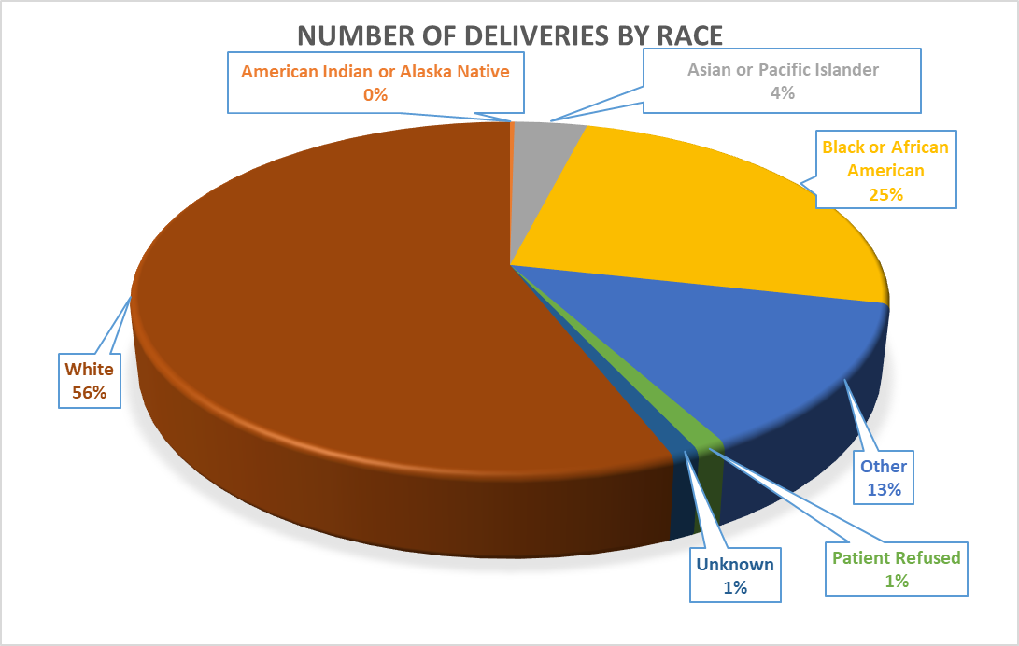
Patient Population & Demographics

Slide 7
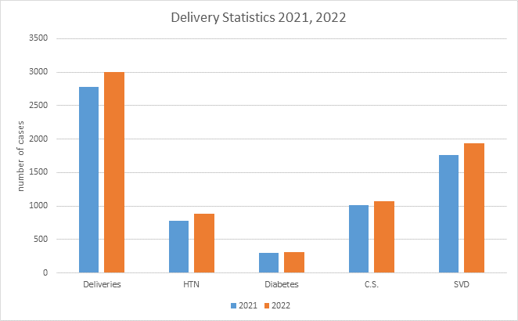
Delivery Statistics

Slide 8
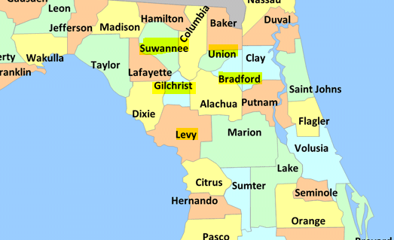
Community Education
Maternal Infant Care Program (five clinics in rural areas)
  Bradford County
  Gilchrist County
  Levy County
  Suwanee County
  Union County

Slide 9
Community Education
Maternal fetal care program (collaboration for high risk patients)
Alachua County grant to support newborn and maternal home visit program including substance treatment
Community Outreach
Multi-Service
Nurse Navigators
Gator-Momiter
Cardio OB
Open Access Lectures
Maternal Transport
Healthy Families and Healthy Start
Follow-up care and telemonitoring
OB Mood Clinic
HIV Program
US Education Conference

Slide 10
Statewide Collaboration
Florida Perinatal Quality Collaborative (FPQC):
-Postpartum Access and Continuity of Care initiative
-Postpartum hemorrhage initiative
-Postpartum hypertension initiative
-Induction of labor initiative (PROVIDE)
Department of Health (DOH):
-Perinatal Morbidity/Mortality Review
-Florida Perinatal Mental Health Collaborative
Other:
-RPICC
Health Family (Home Visit)
Healthy Start

Slide 11
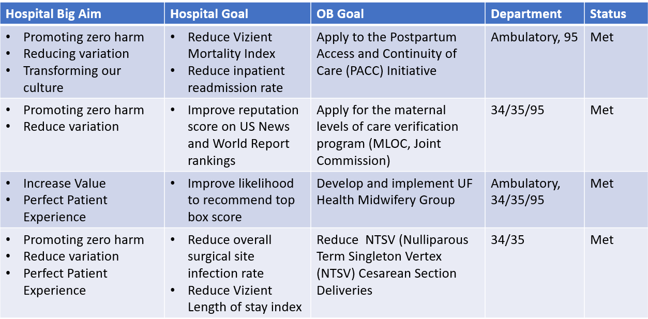
PI Plan 2022

Slide 12
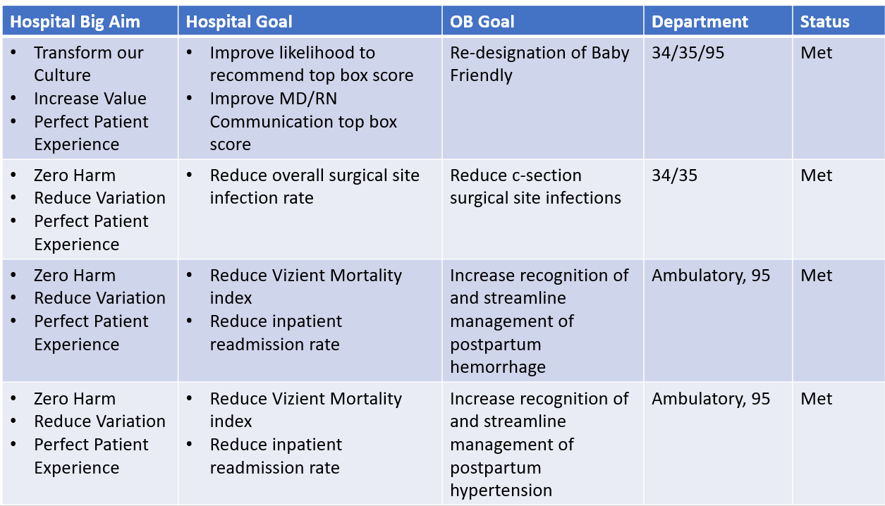
PI Plan 2022

Slide 13
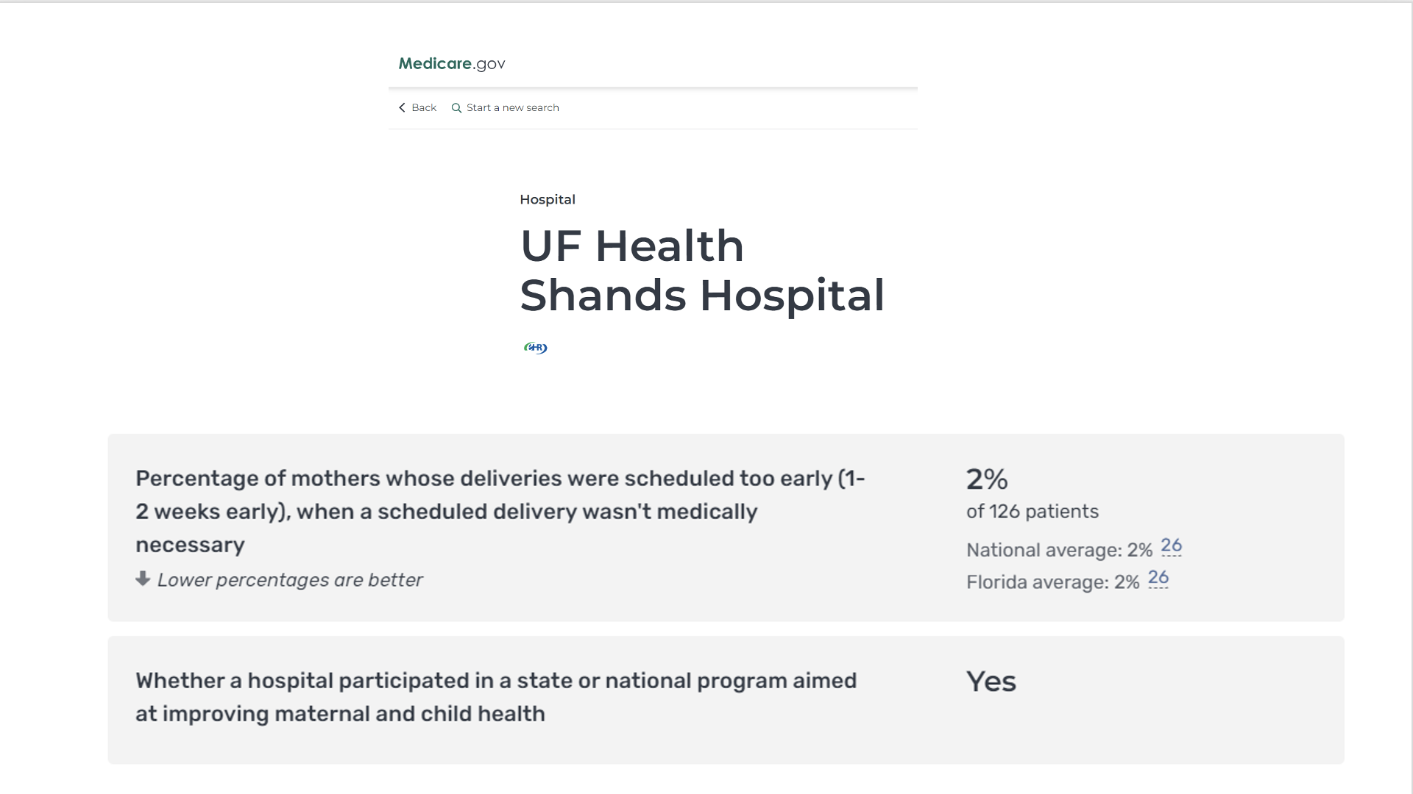
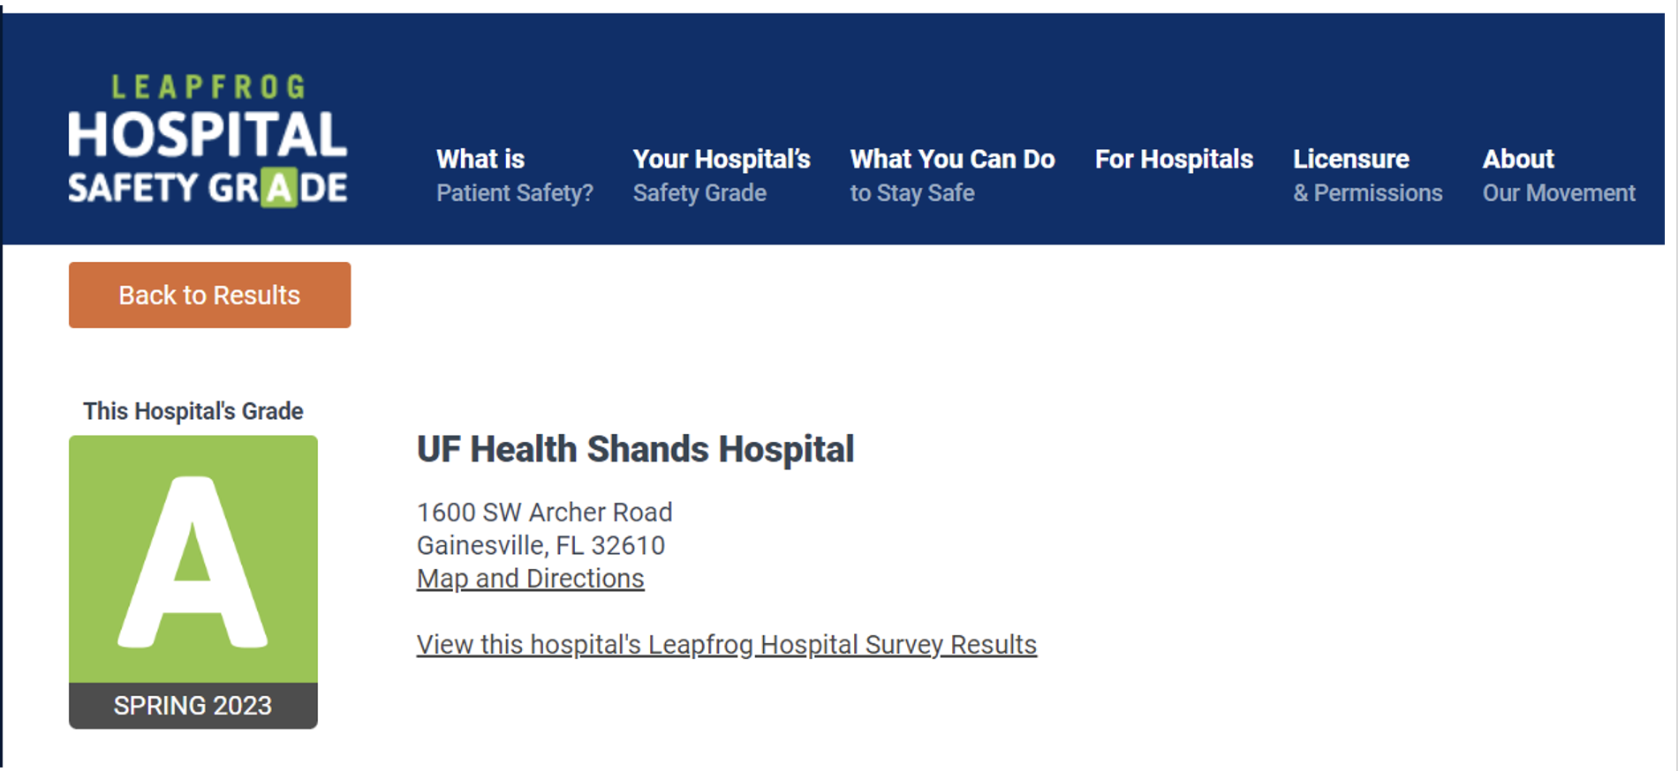
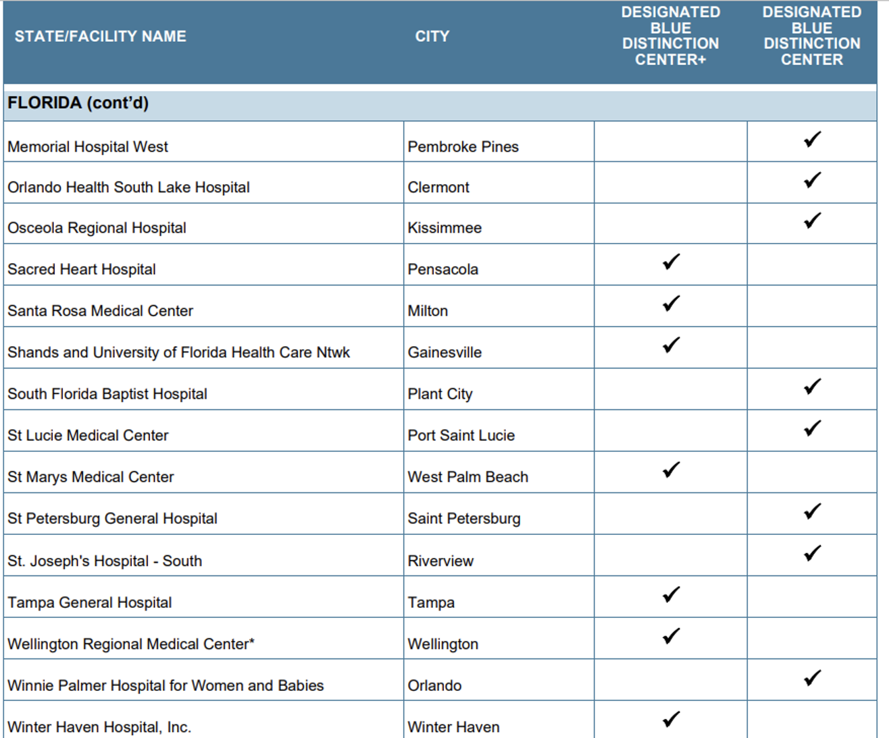
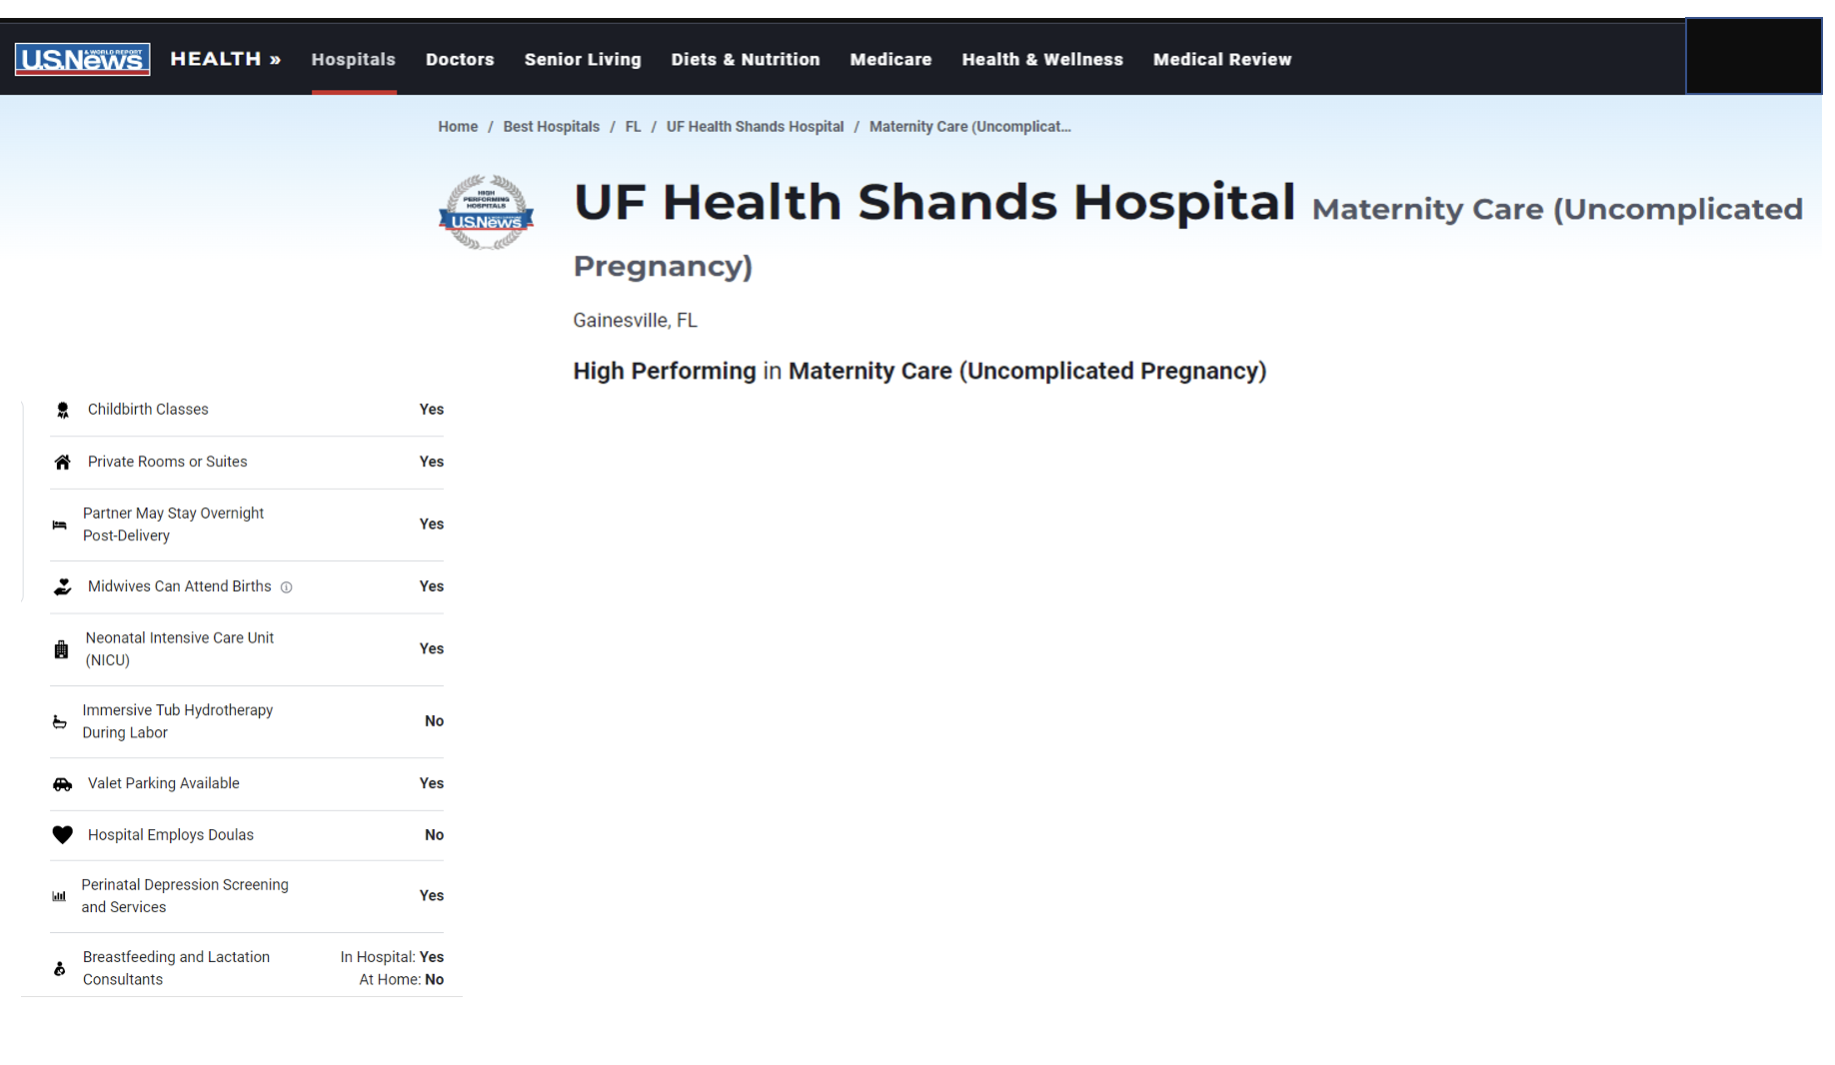
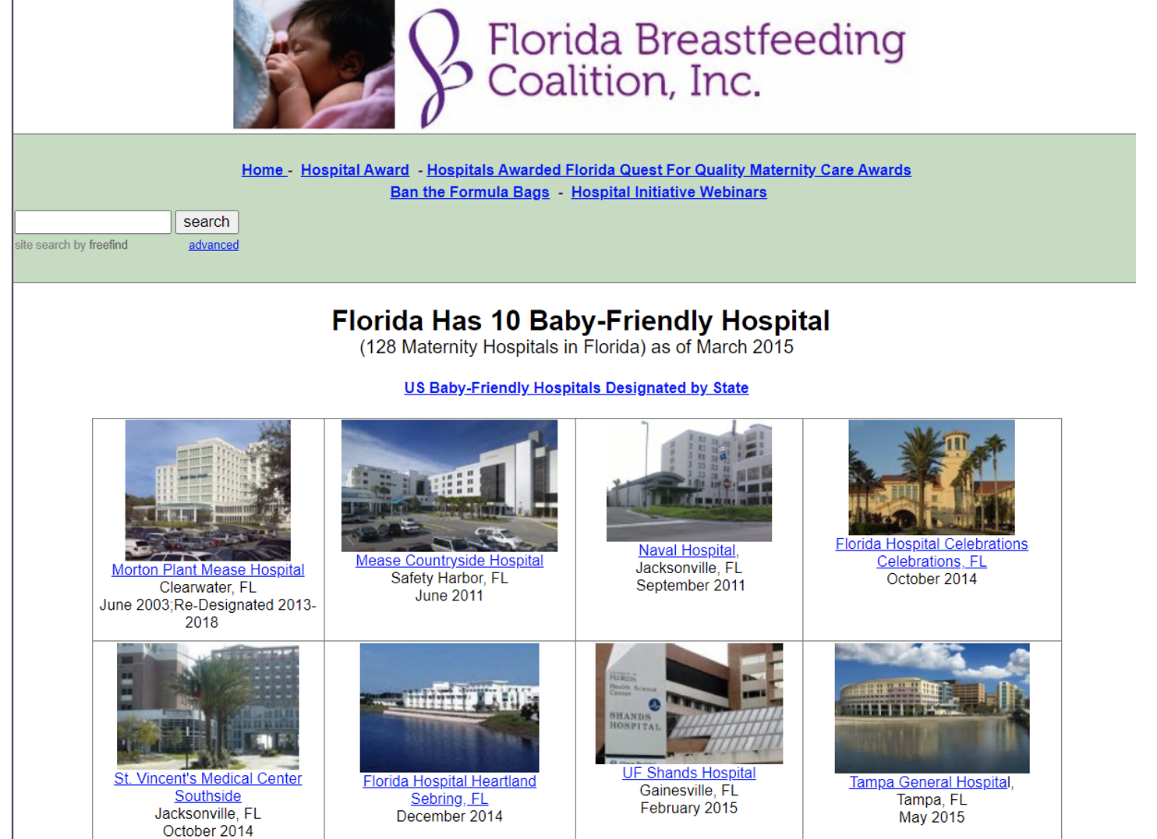
UF Health Shands
Maternity Related Recognitions

Slide 14
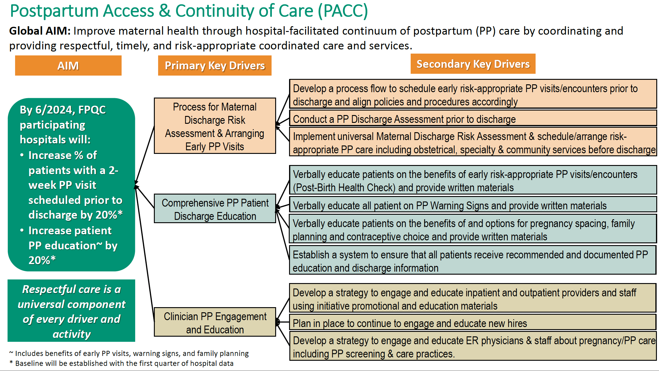
Performance Improvement

Slide 15
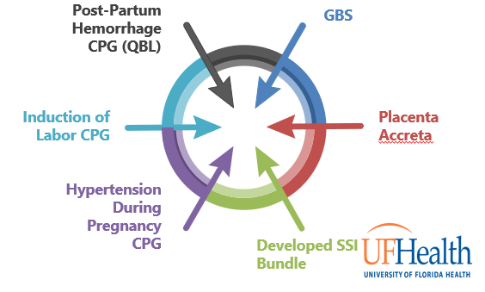
Evidence-Based
Clinical Practice Guidelines

Slide 16
Specialized Training
Specialty Certification (ANCC and NCC) – 89% certified nurses
79% nurses – advanced degrees
SANE trained nurses
Certified Childbirth Educations
Baby Friendly Designation
Magnet
AWHONN Fetal Monitoring Instructor Onsite
Spinning Babies Training for Department
RELIAS

Slide 17
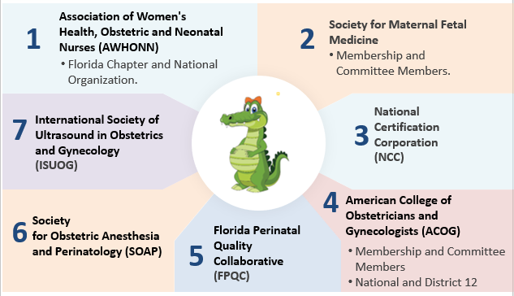
Professional Organizations

Slide 18
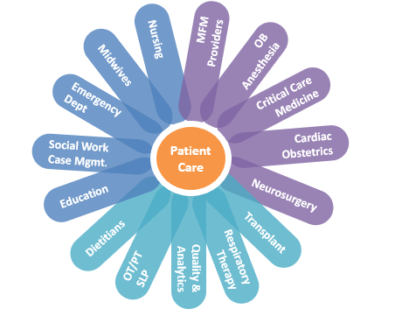
Interdisciplinary Team

Slide 19
Continuing Education and Collaboration
Heart and Pregnancy Conference
Quality and Patient Safety Committee
OB/NICU Perinatal Conference
MFM Fellowship
Placenta Accreta case review
Grand Rounds
OB/Inpatient Collaborative
FHR Monitoring Rounds/AWOHNN EFM Course
Perinatal Care Committee
Interdisciplinary Project Planning
Unit Practice Councils
UF Health Enterprise-wide nursing leadership Perinatal meeting
Pregnancy associated mortality review
Perinatal patient outcomes
Women’s and Children’s Quality Collaborative
OB/ED Collaborative

Slide 20

Regionalization

Slide 21
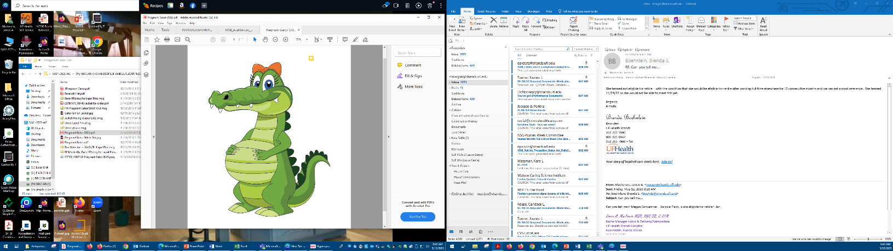
Scope of Services
Labor & Delivery/Antepartum
Our focus is on providing a memorable, family centered birth experience in a safe environment regardless of risk or delivery type.
12-bed Antepartum Service managed by MFM and staffed by Labor & AP trained RNs. This unit is immediately adjacent to L&D and the ORs
5-Bed Triage Unit that can flex to support birth
4-Pre-op/Recovery bed spaces
3 Operating Room Suites
8 newly renovated labor rooms

Slide 22

Scope of Services
Labor & Delivery/Antepartum
Patient Population/Visits
~500 Triage visits a month with a 40% admission rate
Deliveries are increasing ~240-260/month
35% overall cesarean rate that is beginning to trend down
Patients >20weeks with some exceptions on L&D and all gestational ages on the AP Unit ( Average 10-12 patient per day)

Slide 23
Scope of Services
Labor & Delivery/Antepartum
Nursing Care
BSN (>70%) and National Certification (>90%), with specialty training
Staffing is based on AWHONN recommendations and Guidelines for Perinatal Care
Surges are managed with on-call and support from Central Staffing/Peds

Slide 24
Scope of Services
Unit 95
Our philosophy on unit 95 is to set a new standard of nursing excellence by providing experienced nursing care to high risk populations with Pre-Eclampsia, Post-Partum Hemorrhage, and other comorbidities. We provide comprehensive family-centered care through the postpartum period by supporting and providing education on rooming in, maternal/infant bonding, lactation, newborn care, and postpartum maternal care to ensure our patients have a successful transition into the fourth trimester.
23 private beds and a newborn procedure room
Services include: Postpartum care, Newborn care, overflow for Antepartum and Gynecology
Care is provided by RN, LPN, PCA, and Support Techs with an 83/17 skill mix
Highly experienced nursing care:
  92% BSN rate
  87% National Certifications (38% Med-Surg certified, 22% Lactation certified, 28% Maternal Newborn, 6% Child Birth Educator Certified, 3% Cardiovascular certified, 3% Neonatal certified- Providing expansive expertise).
  Average seniority of 8.7 years

Slide 25
Case
43 yr old G8 3043 transferred at 19 weeks in heart failure, patient was intubated and on pressors for support on admission
BNP 1300, TTE was 25%
Medically managed and extubated 1 week after admission
Next day patient had an arrest requiring 3 rounds of CPR and reintubated. IABP was placed.
1 day later she was extubated
3 days later c/o severe abdominal pain had large rectus sheath hematoma Rx IR embolization
At 22 5/7 weeks patient condition began to deteriorate, multidisciplinary meeting with MFM, Neonatal, Cardiology, CT Surgery and Anesthesia held decision made to place an Impella Heart Pump
At 28 weeks elective delivery by Cesarean Section
Post OP CS Day 19 patient discharged

Slide 26
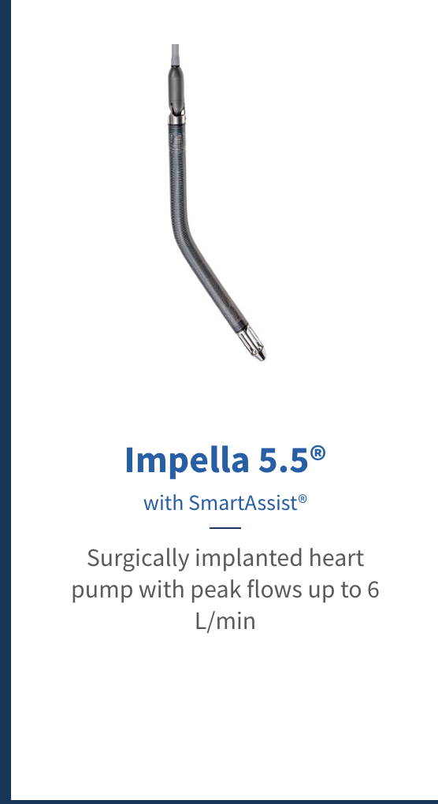
Case

Slide 27


Questions?

